Slide 1
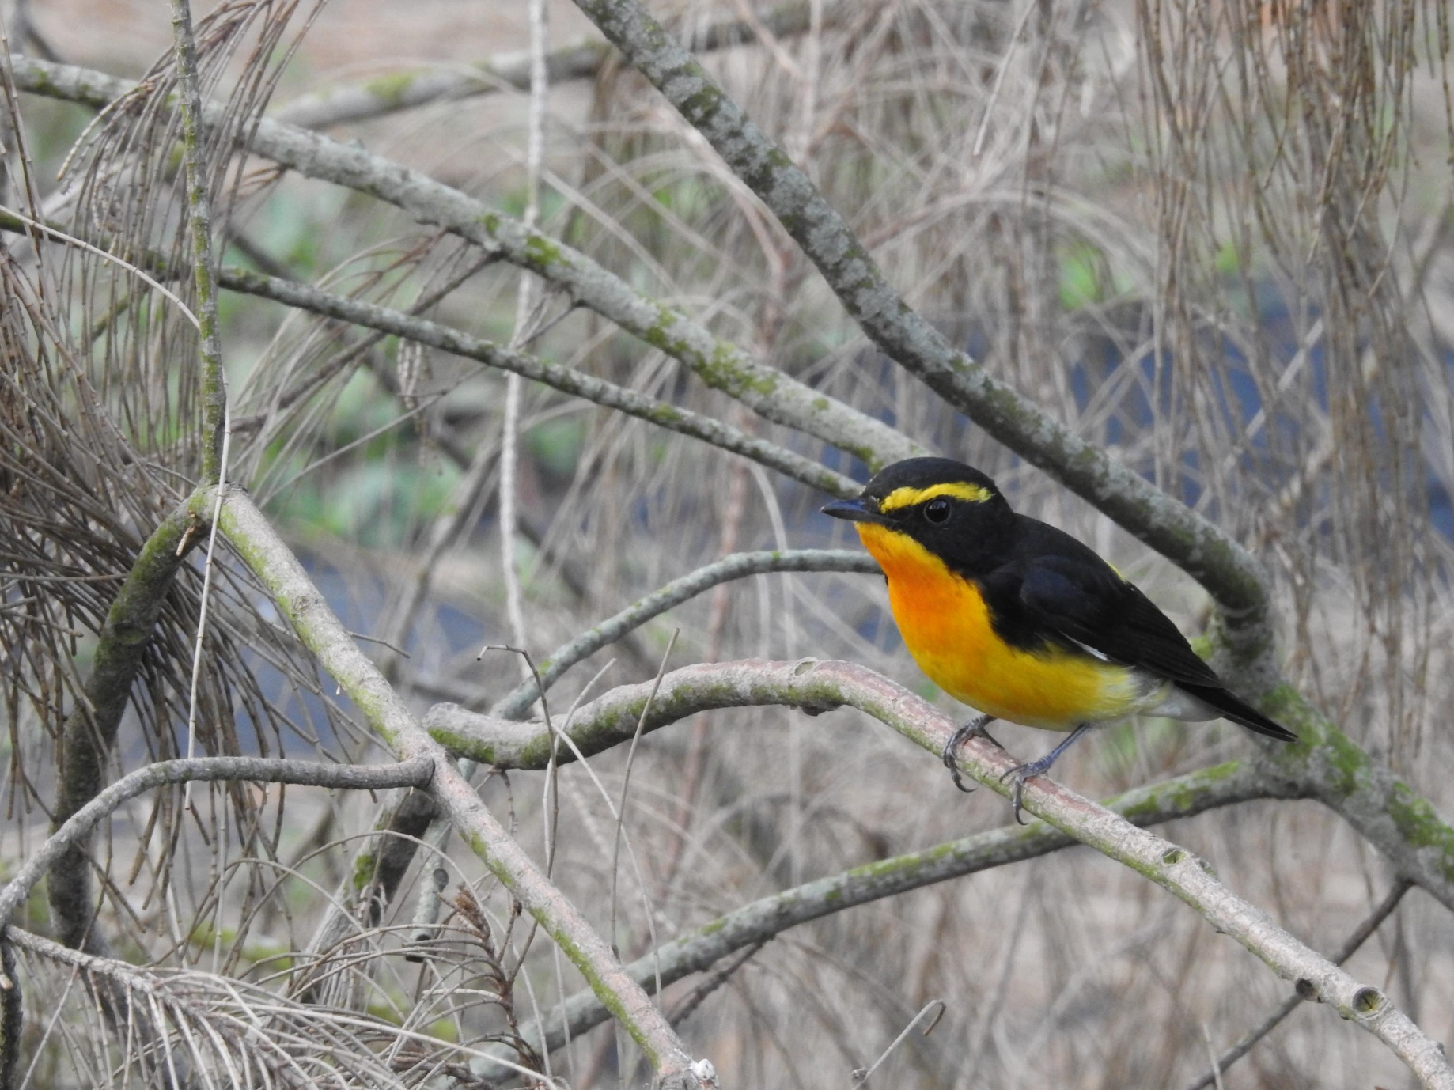
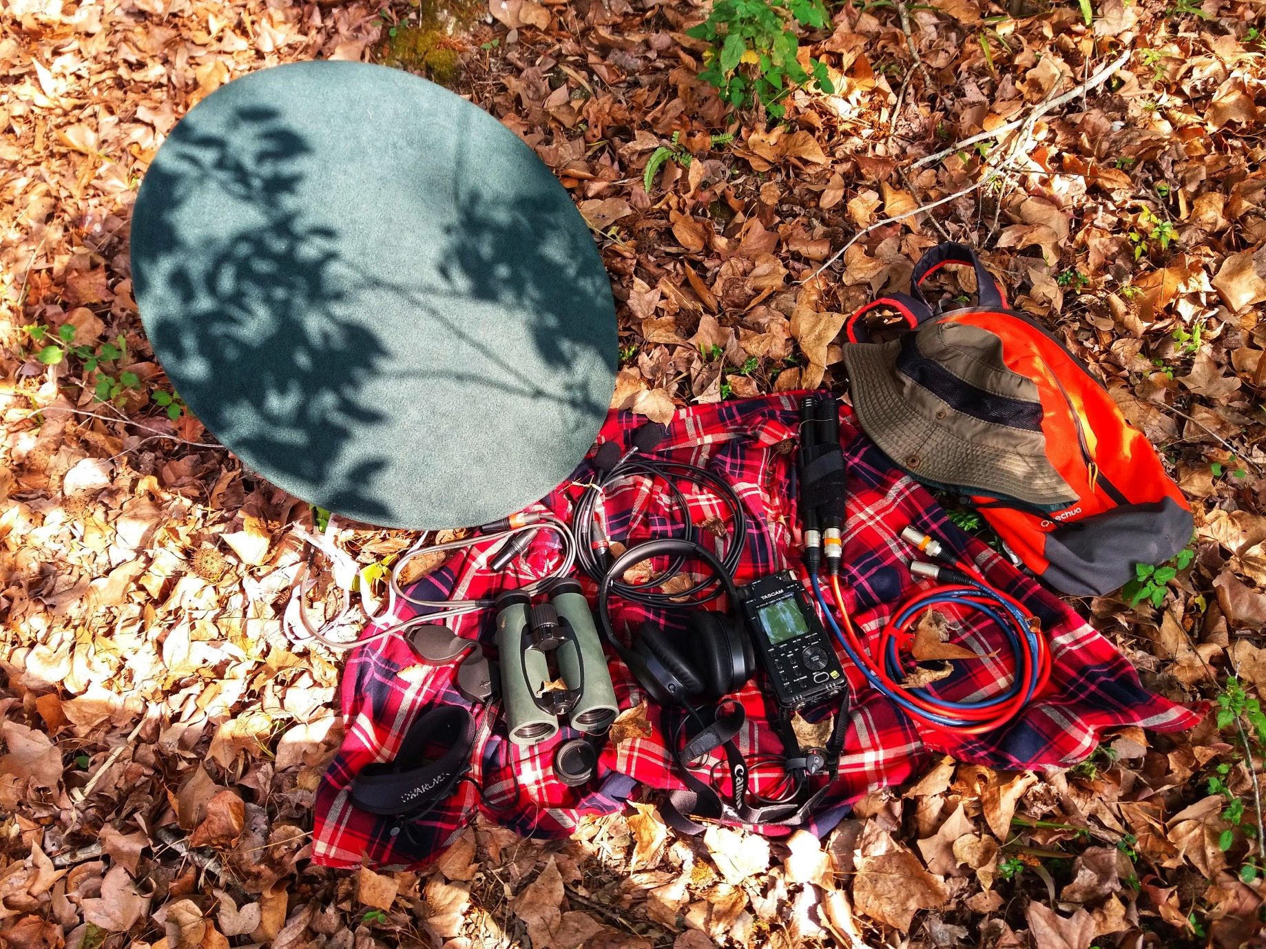
Automated Audio Monitoring in Ornithology
CABE 2024 at Taipei
Sunny Tseng
PhD candidate, University of Northen BC
2024 Jan. 23rd
Notes:
Narcissus Flycatcher

Slide 2
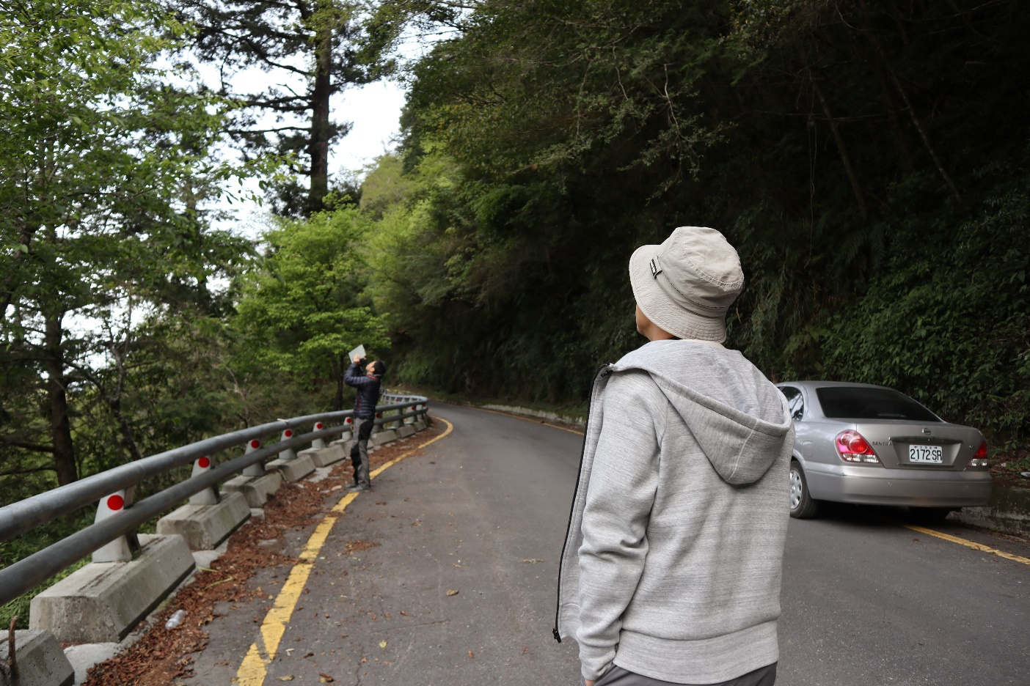
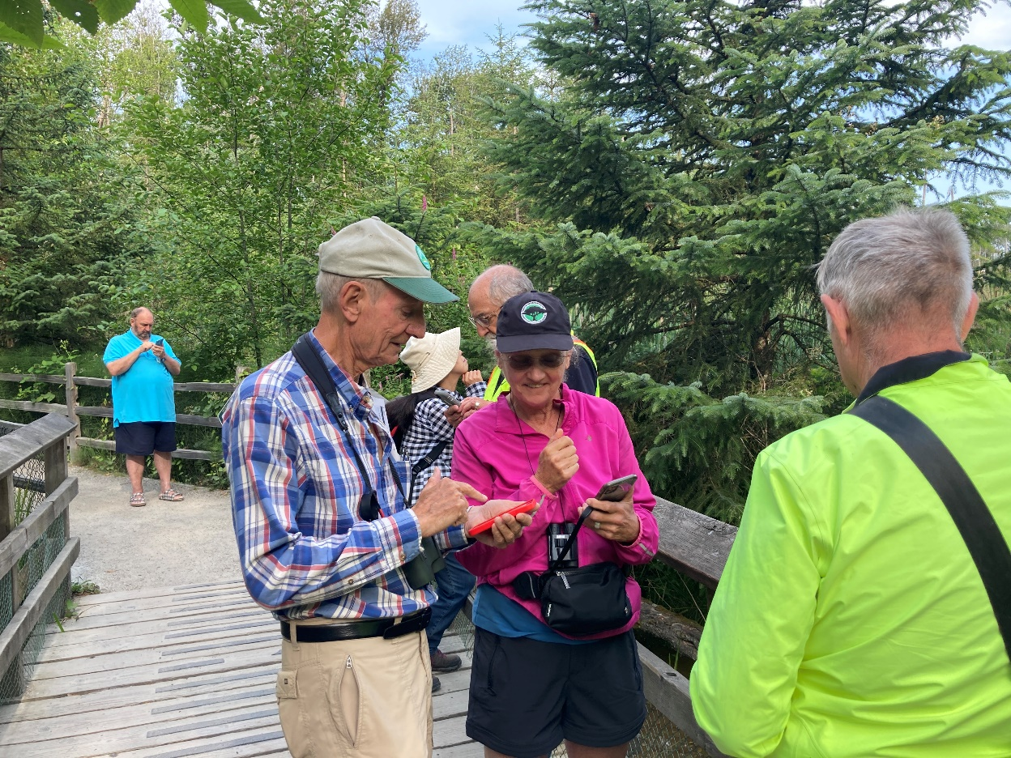
Technology advances in birding
Most of the birds are heard rather than seen in the field
From ears to digital recorders

Slide 3
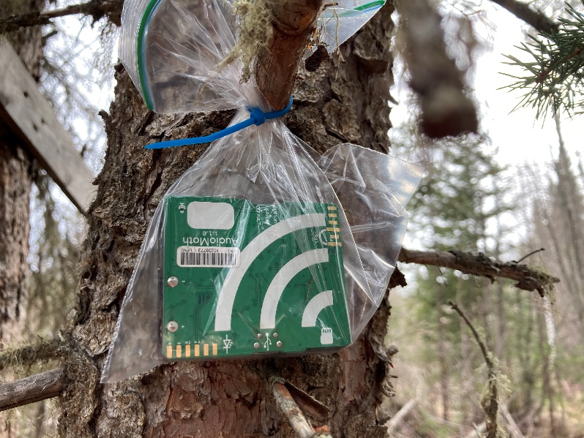

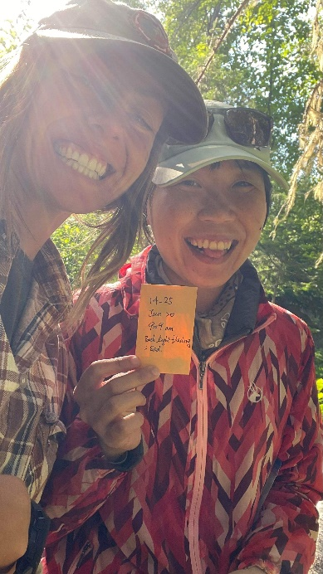
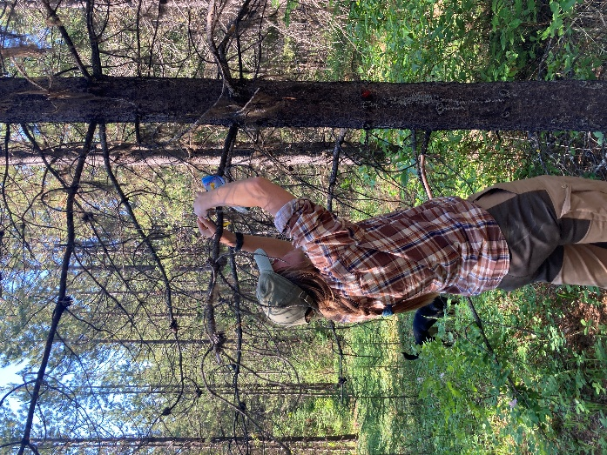
Autonomous recording units (ARU)
Bird sound activity → avian biodiversity
AudioMoth, LabMaker, ~ 80 CAD/unit
Song Meter, Wildlife Acoustic, ~ 700 CAD/unit
How it sounds like… (2021 Mar 5th)
How to set up
Schedule
Price

Slide 4
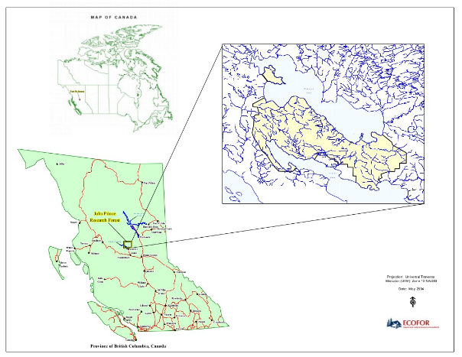
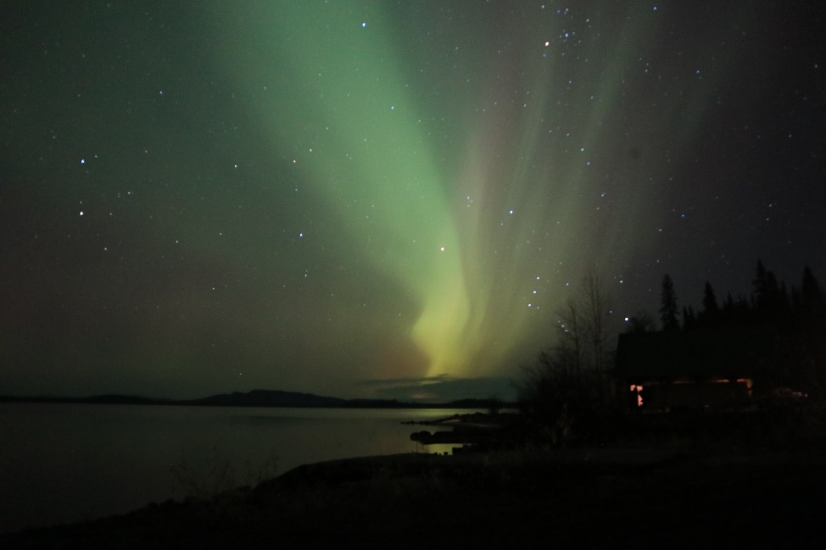
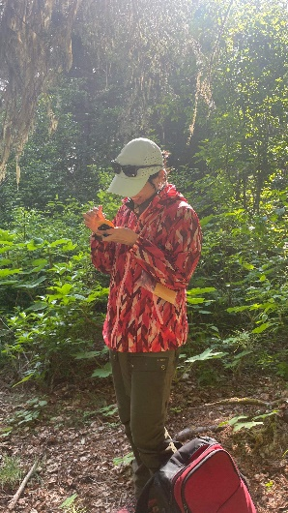
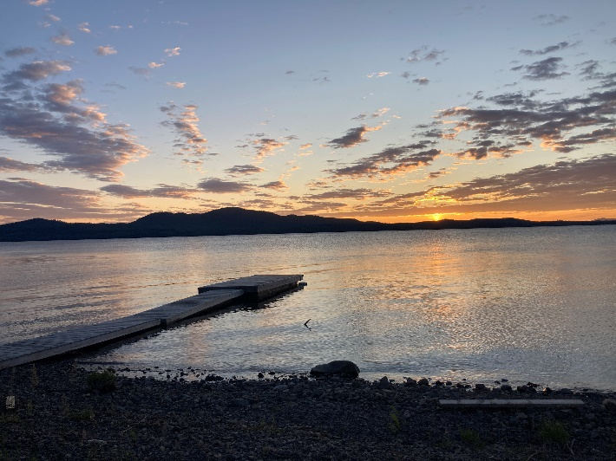
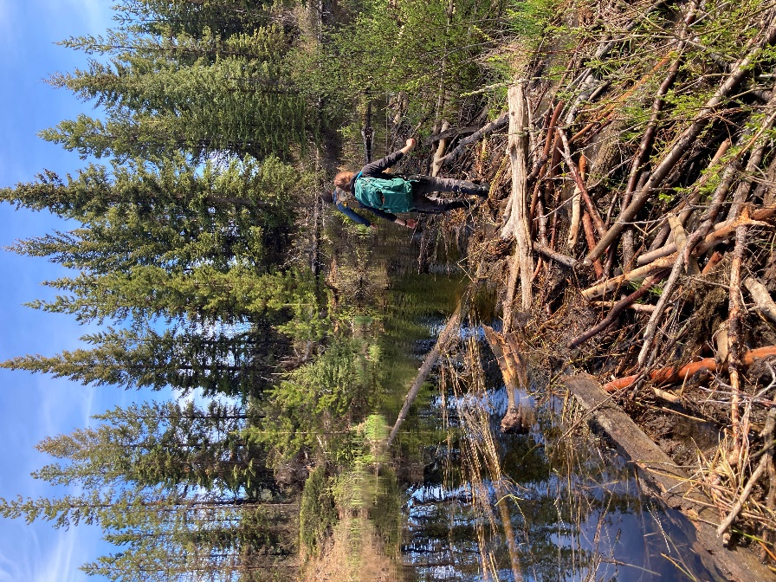
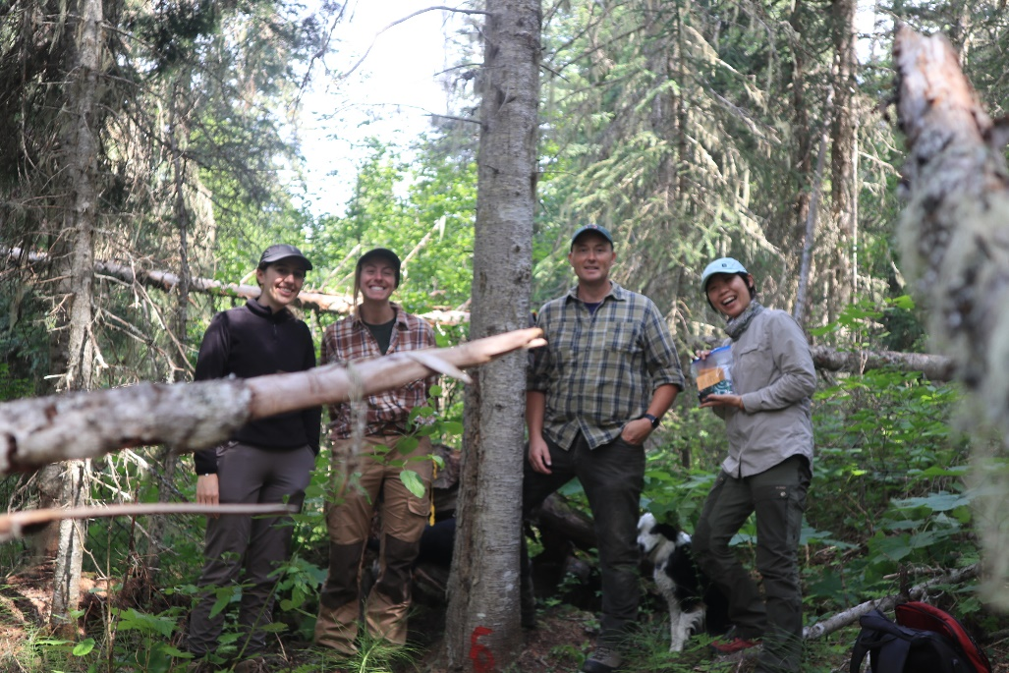
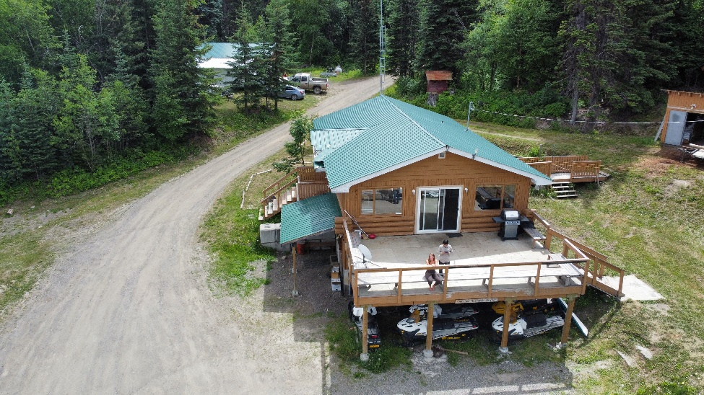
Study area - John Prince Research Forest

Slide 5
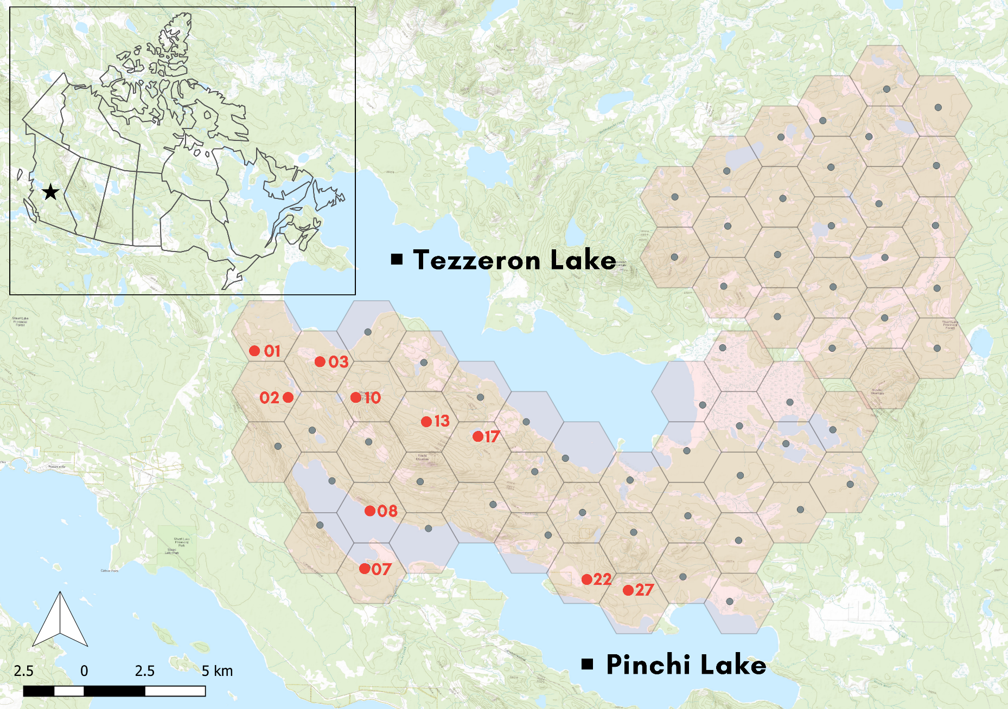
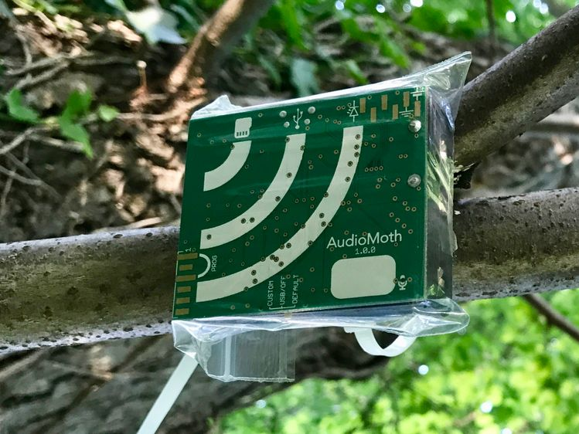
Study area - John Prince Research Forest
66 AudioMoth
~3 km apart
Taipei city*2
2020 - 2022
~ 1,500 hours audio
~ 15 TB of data

Slide 6
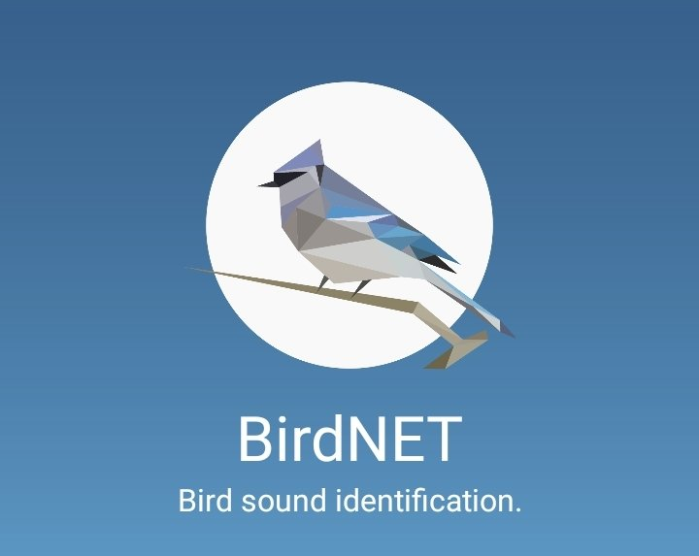


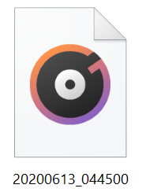
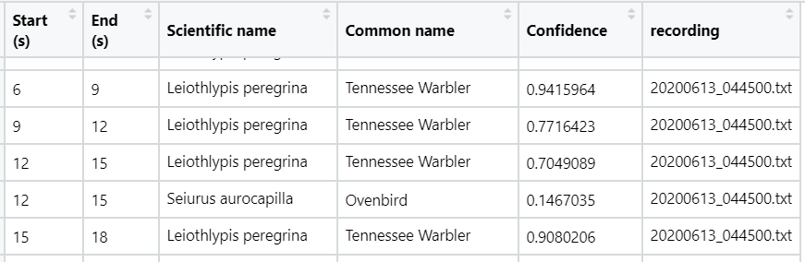
How does BirdNET work?
500 training recordings for each species
~ 800,000 recordings
+
Can identify ~ 6 thousands of species around the world
~ 2,000,000 recordings
(Kahl et al., 2021)
BirdNET

Slide 7
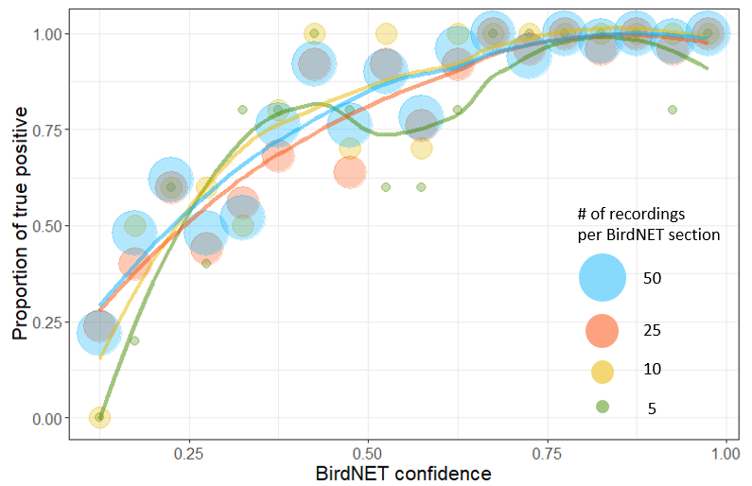
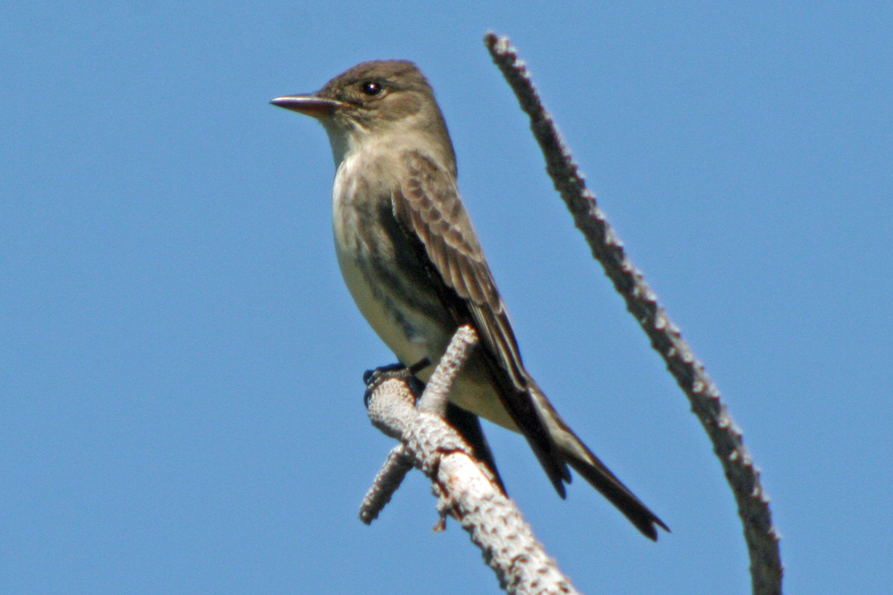
Calibration curve
Olive-sided Flycatcher
Plot confidence value vs the proportion of true detections (TP)
The higher the confidence, the higher proportion of TP
Use this curve to evaluate the performance of BirdNET

Slide 8
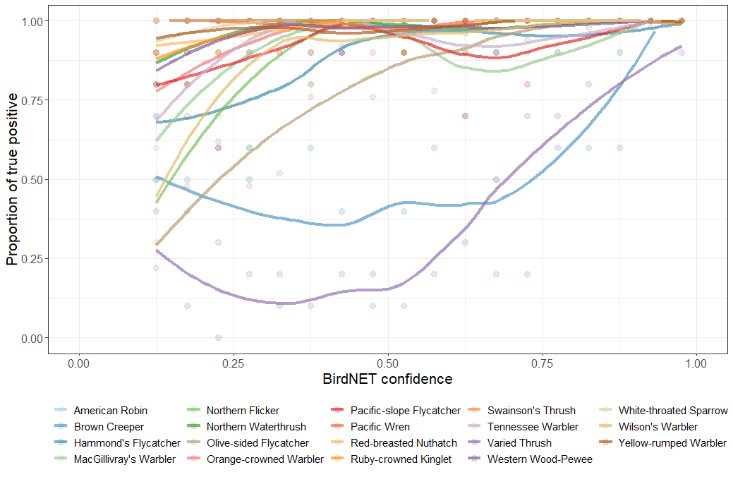
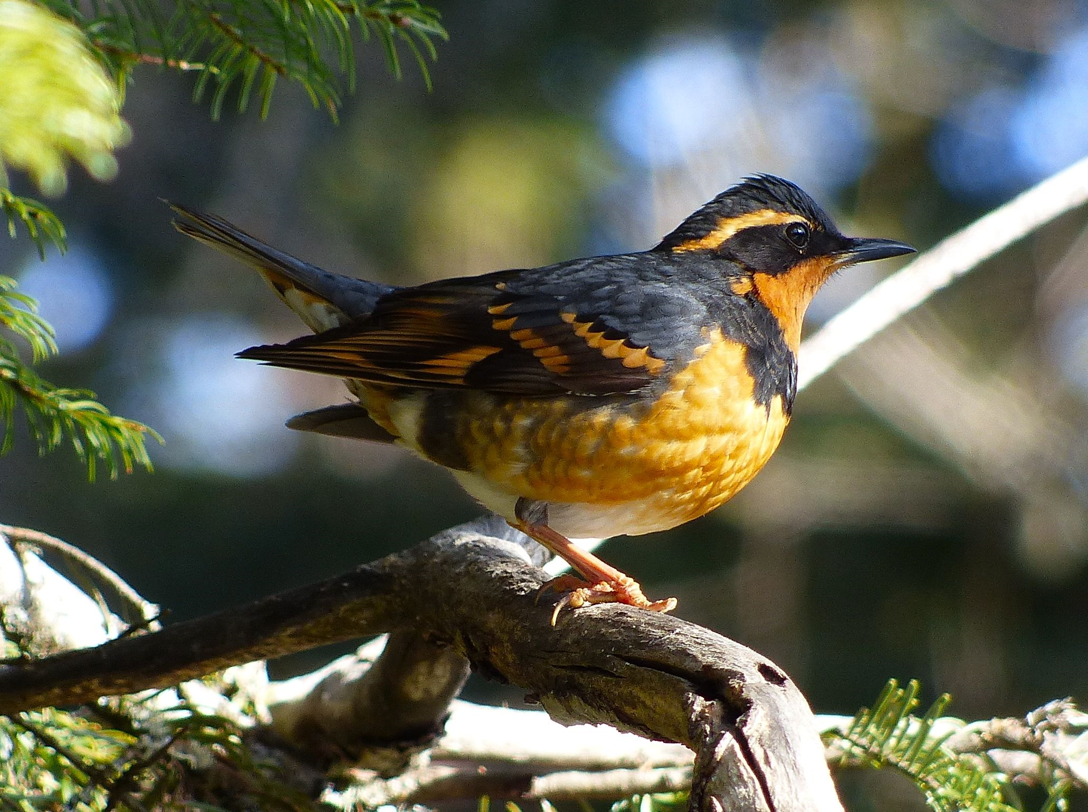
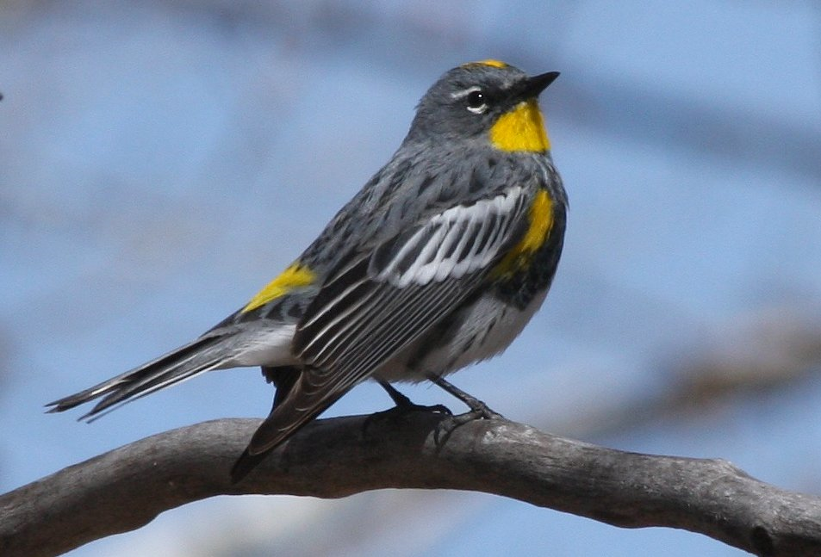
BirdNET on 19 common species
Low performance: confidence values need to be high for true detection
- Varied Thrush
- Brown Creeper
High performance: True Positives is high even with low confidence values
- Yellow-rumped Warbler
- Red-breasted Nuthatch
- Pacific Wren

Slide 9
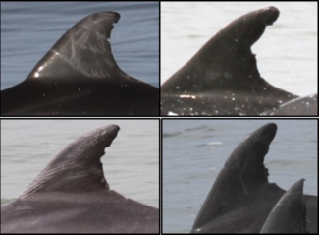
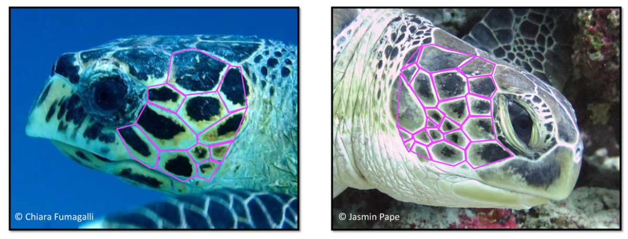
Individual identification of animals
Individual interactions in social hierarchy
Resources use and physical development
Mapping individual territory
Physical tags
GPS tracking
Physical features
Captures of animal & visual
Vocal individuality of Owl
(Jean et al., 2010)

Slide 10
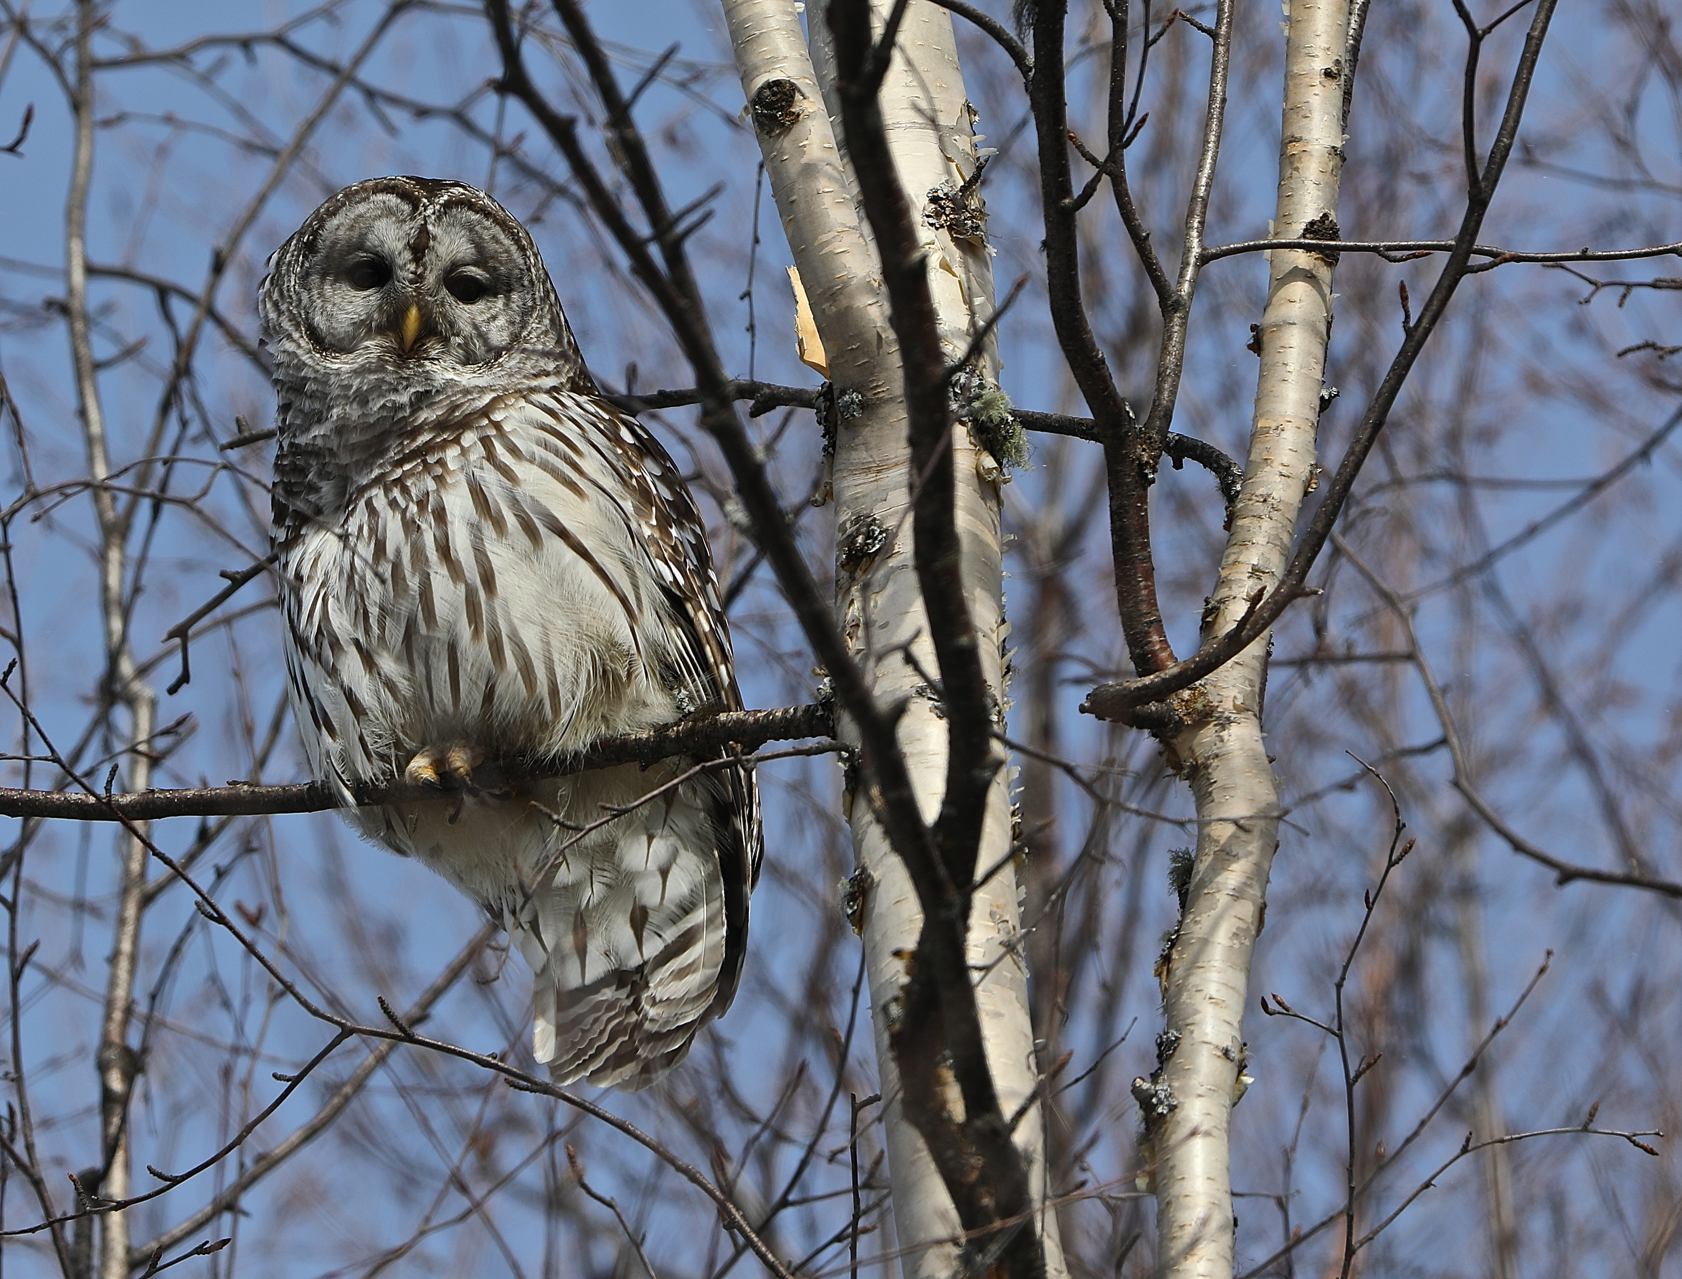
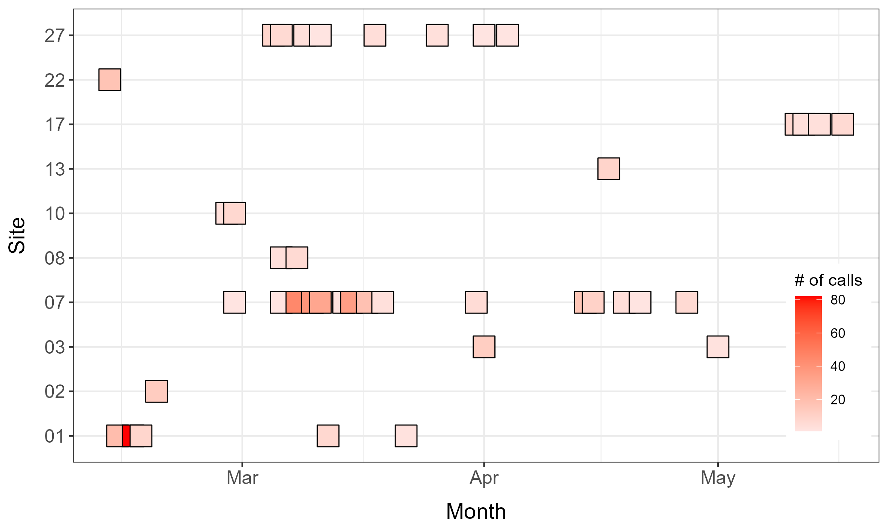
Temporal distribution
454 Barred Owl calls
10 recorder stations
Most of the calls in March, when they are defending territory
Less call at the end of the season as the territory area is already set
Photo credit: Roy V Rea

Slide 11
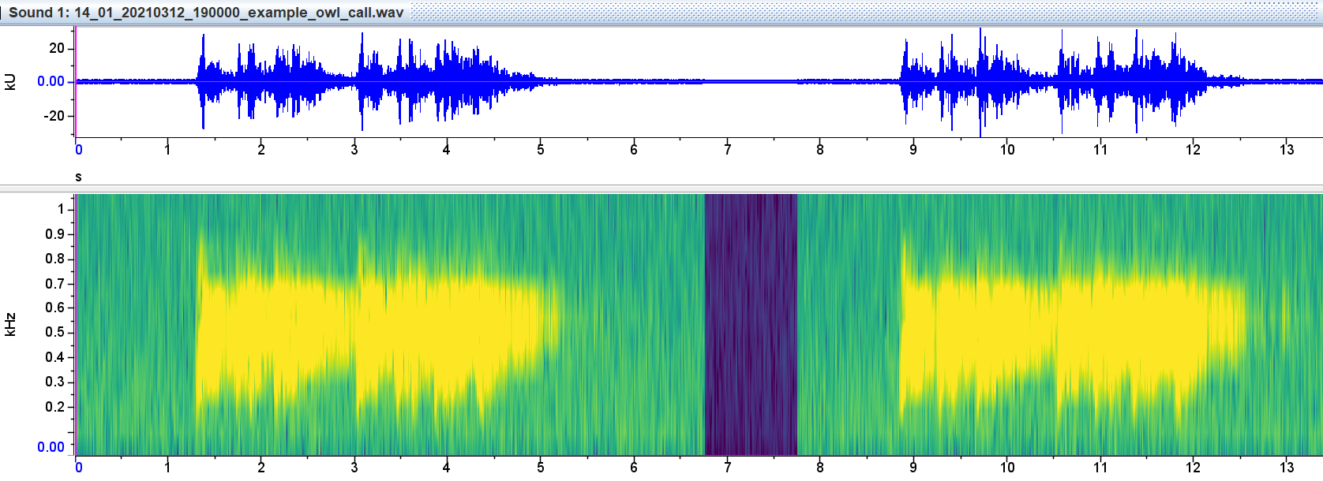
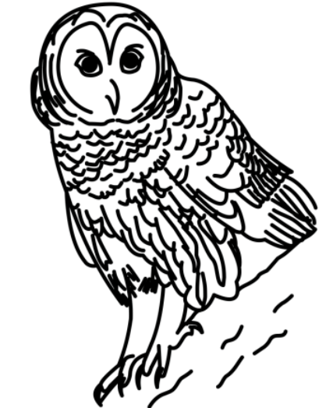
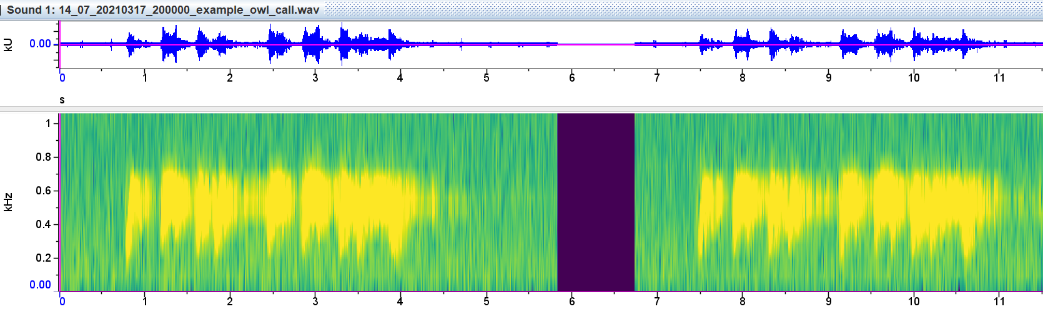
Territorial calls from different sites
14_01
14_07

Slide 12
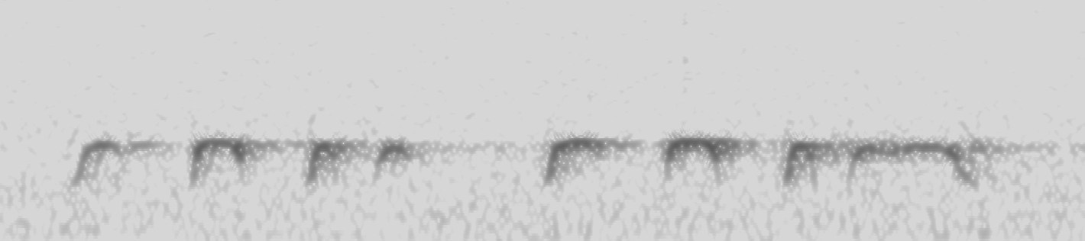
Owl spectrogram & sound features
Temporal features: 12
Frequency features: 18
Measure these 30 features for all 454 extracted calls
sl
1
0.5
0
d1 – 8
i3
i1
i2
max_d
Frequency (kHz)
dfr1 – 8
md1 – 8
min_d
0 0.5 1 1.5 2 2.5 3 3.5
Time (s)

Slide 13
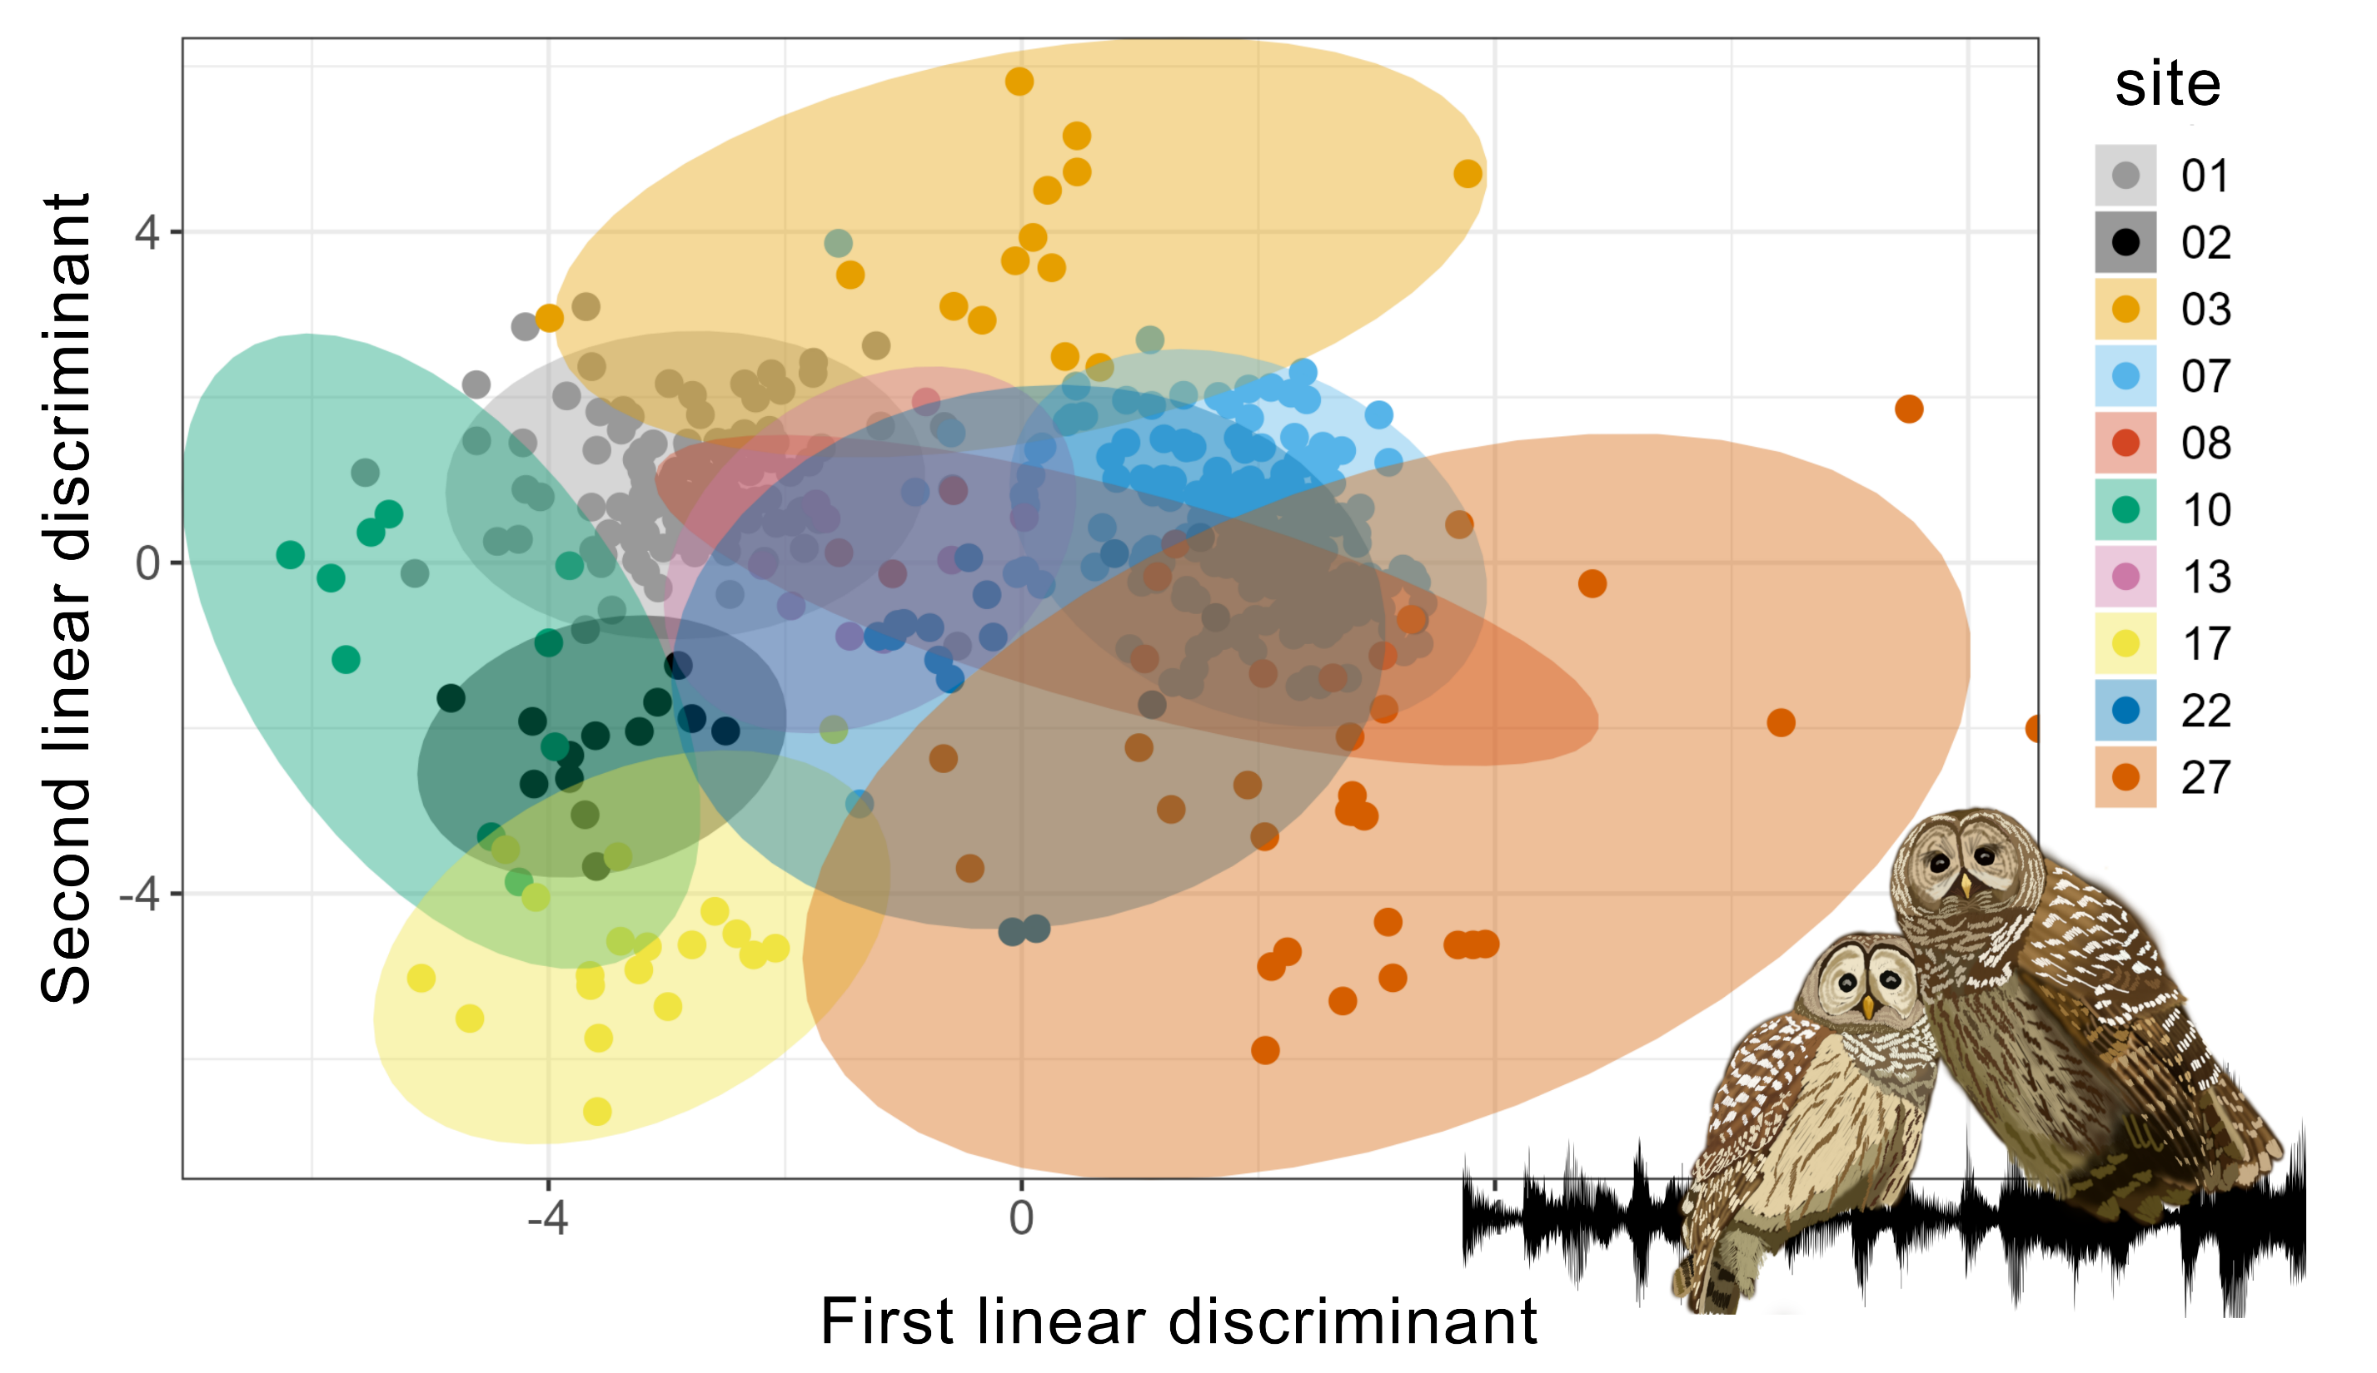
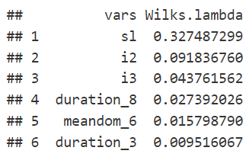

Slide 14
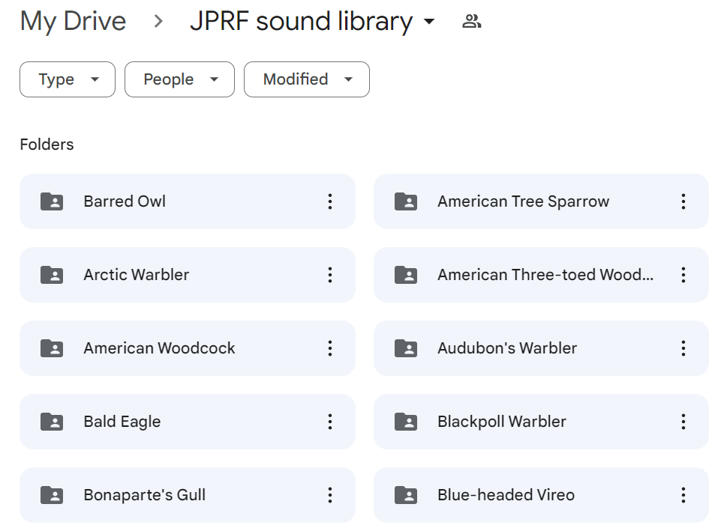
BirdNET ARU sound library
131 species → 96 species
Manual validation
eBird distribution map
BBS Atlas Prince George
JPRF sound library

Slide 15
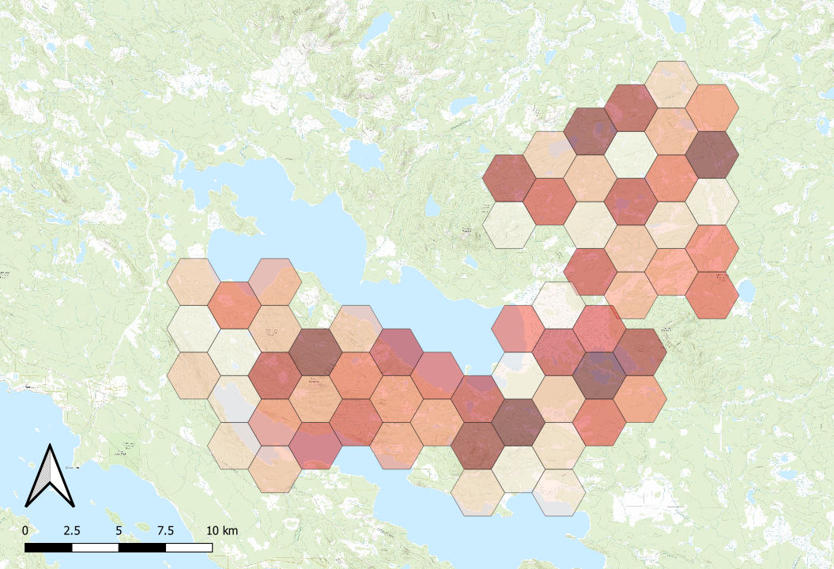
Richness map (96 ARU species)
Richness
40
30
20
10

Slide 16

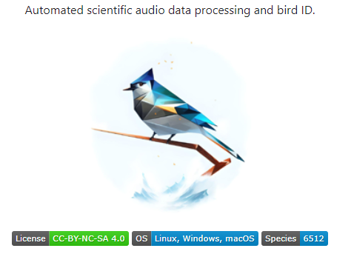
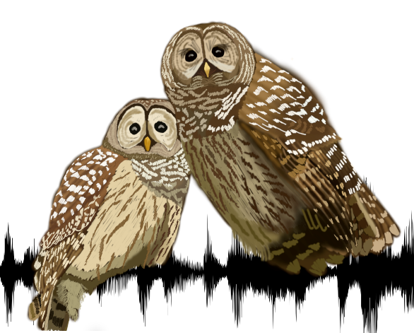
What we have talked about
AudioMoth + BirdNET is powerful for accessing biodiversity
BirdNET performs differently across different bird species
Audio collected by AudioMoth enables individual owl monitoring
Large-scaled monitoring

Slide 17
Happy Birding!
With technology!

Slide 18
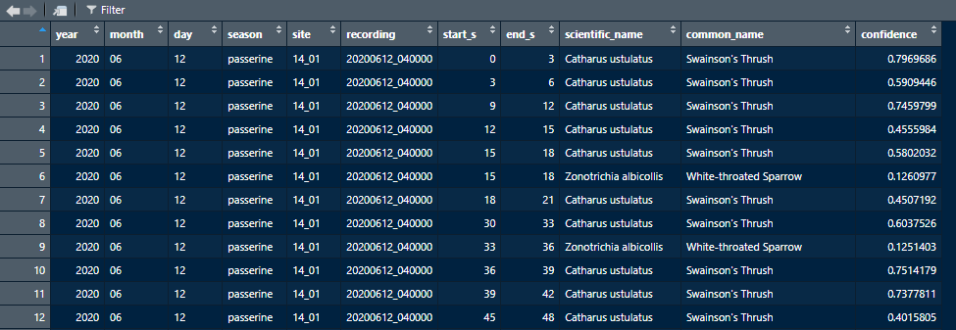
Run audios through BirdNET
How can we know the threshold of “true” detection?
1/10 time consumption → 150 computer hours
Confidence value for detections

Slide 19
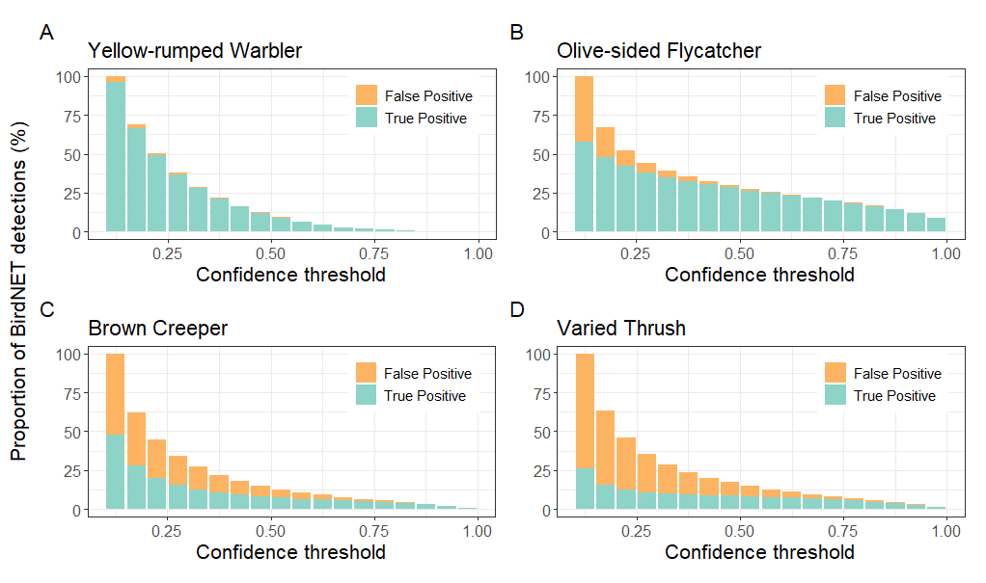
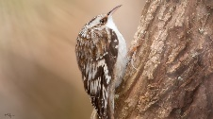
Threshold Setting

Slide 20
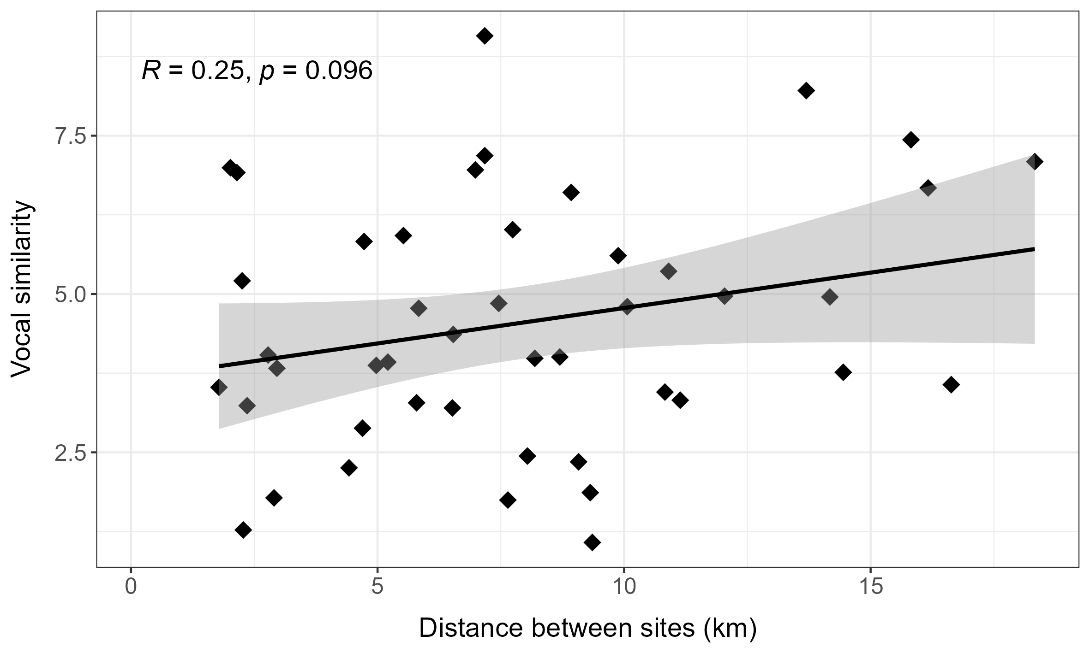
Spatial distance vs vocal similarity
Same birds flying around and get recorded by multiple ARUs?
→ No

Slide 21
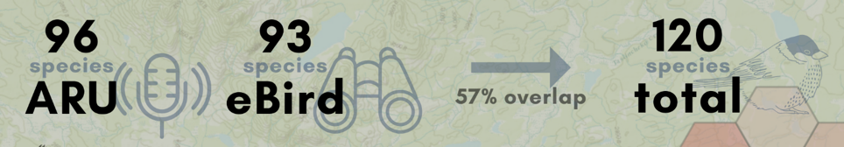
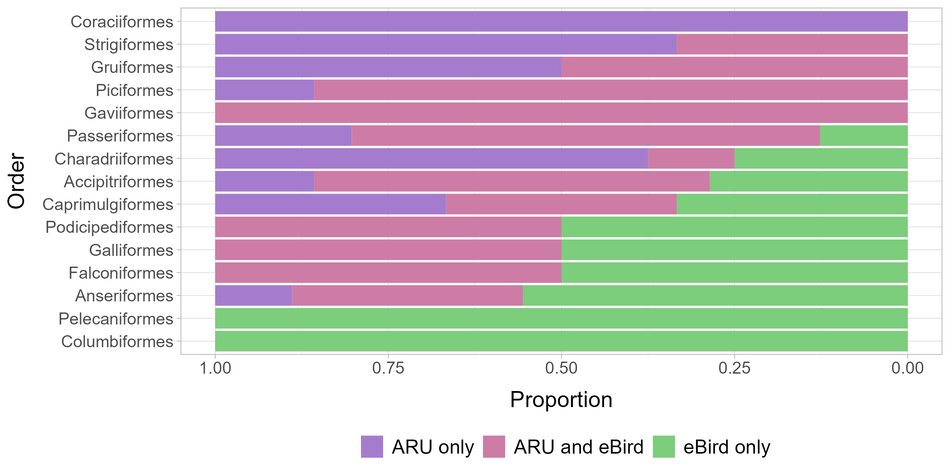
ARU vs eBird

